Slide 1
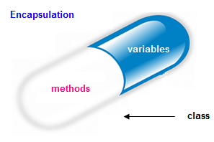
Encapsulation
Encapsulation in java is a process of wrapping code and data together into a single unit, for example capsule i.e. mixed of several medicines.
We can create a fully encapsulated class in java by making all the data members of the class private. Now we can use setter and getter methods to set and get the data in it.
The flexibility of a program is increased by making the variables as write-only or read-only by omitting the getter and setter methods.

Slide 2
Tightly Encapsulated Class
The tightly encapsulated class is a class whose every variable is declared private, whether getter or setter methods are present or not or they are marked as public or not.
class P
{
int p =19;
//not tightly encapsulated class
}
class Q extends P
{
private int q=20;
//not tightly encapsulated class because it extends class P
}
class R extends Q
{
private int r=23;
//not tightly encapsulated class because it extends class Q
}

Slide 3
Final

Slide 4
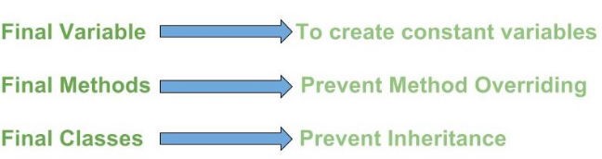
Final
Final keyword is used to restrict further modification of a variable or a method or a class.
The value of a variable which is declared as final can’t be modified once it gets a value. A final method can not be overridden in the sub class and you can not create a sub class to a final class.

Slide 5
Without Final Keyword
class testModifiers
{
int a=20;
}
public class demoModifiers extends testModifiers {
public static void main(String args[])
{
demoModifiers obj=new demoModifiers();
obj.a=25;
System.out.println(obj.a);
}
}
Output: 25

Slide 6
Final Keyword with Variable
class testModifiers
{
final int a=20;
}
public class demoModifiers extends testModifiers {
public static void main(String args[])
{
demoModifiers obj=new demoModifiers();
obj.a=25; // Error
}
}

Slide 7
Final keyword with class
final class testModifiers
{
int a=20;
}
public class demoModifiers extends testModifiers { // Error
public static void main(String args[])
{
demoModifiers obj=new demoModifiers();
}
}

Slide 8
Function without Final Keyword
class ParentClass {
public void fun() {
System.out.println("Parent class fun ");
}
}
public class ChildClass extends ParentClass{
public void fun() {
System.out.print("Child class fun");
}
public static void main(String args[]) {
ChildClass c = new ChildClass();
c.fun();
}
}

Slide 9
Function with Final Keyword
class ParentClass {
final void fun() {
System.out.println("Parent class fun ");
}
}
public class ChildClass extends ParentClass{
public void fun() { // error
System.out.print("Child class fun");
}
public static void main(String args[]) {
ChildClass c = new ChildClass();
c.fun();
}
}

Slide 10
Polymorphism

Slide 11
Polymorphism
Polymorphism comes from Greek meaning “many forms.”
Polymorphism is the ability of an object to take on many forms. The most common use of polymorphism in OOP occurs when a parent class reference is used to refer to a child class object.

Slide 12



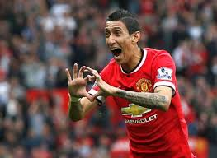
Polymorphism
Test
Move
.
.

Slide 13
Inheritance
class A{
int x;
public void test(){
System.out.print("Hello from class A");
}
}
class B extends A{
int y;
public void test(){
System.out.print("Hello from class B");
}
public void test2(){
System.out.print("Hello from class B");
}
public static void main(String args[]){
B b1= new B(); //Reference of child class
b1.x =5;
b1.y=23;
b1.test();
b1.test2();
}
}

Slide 14
class A{
int x;
public void test(){
System.out.print("Hello from class A");
}
}
class B extends A{
int y;
public void test(){
System.out.print("Hello from class B");
}
public void test2(){
System.out.print("Hello from class B");
}
public static void main(String args[]){
A a1= new B();
a1.x =5;
a1.y=23; //Error
a1.test();
a1.test2(); //Error
}
}
Polymorphism
Whatever method u want to call using obj reference of Parent type, those method should present in Parent class because during compile time the compiler will strictly check for those methods presence in Parent class even though it may be present in Child class

Slide 15
why subclass reference can't hold superclass object in java
class One{
}
class Two extends One{
}
class Main{
public static void main(String[] args){
Two t = new One(); //Error
}
}

Slide 16
why subclass reference can't hold superclass object in java
class Animal{
void eat(){
System.out.println("eating...");
}
}
class Dog extends Animal{
void bark(){
System.out.println("barking...");
}
}
class Cat extends Animal{
void meow(){
System.out.println("meowing...");
}
}
class TestInheritance3{
public static void main(String args[]){
Cat c=new Cat();
c.meow();
c.eat();
}
}
Output:
meowing...
eating...
Because a dog has all the behaviors of an animal, but something that is only known to be an animal is not guaranteed to have all the behaviors of a dog.

Slide 17
Polymorphism (Dynamic Binding)
class Shape{
void draw(){System.out.println("drawing...");}
}
class Rectangle extends Shape{
void draw(){System.out.println("drawing rectangle...");
}
class Circle extends Shape{
void draw(){System.out.println("drawing circle...");}
}
class Triangle extends Shape{
void draw(){System.out.println("drawing triangle...");}
}
class TestPolymorphism{
public static void main(String args[]){
Shape s;
s=new Rectangle();
s.draw();
s=new Circle();
s.draw();
s=new Triangle();
s.draw();
}
}
Output:
drawing rectangle...
drawing circle...
drawing triangle...

Slide 18
class Bank{
float getRateOfInterest(){
return 0;
}
}
class HBL extends Bank{
float getRateOfInterest(){
return 8.4f;
}
public void a(){}
}
class Allied extends Bank{
float getRateOfInterest(){
return 7.3f;
}
public void b(){}
}
Polymorphism (Dynamic Binding)
class TestPolymorphism{
public static void main(String args[]){
Bank b;
b=new HBL();
System.out.println("HBL Rate of Interest:"+b.getRateOfInterest());
b=new Allied();
System.out.println("Allied Rate of Interest: "+b.getRateOfInterest());
}
}

